Slide 1

Exploring health quality
Coung Huynh
Erica Rosa
Jensen Binoji
Ted Stagner

Slide 2

Background
From fee-for-service, towards value based care
Quality Incentive Programs (Payment model change)
High performers → Positive reimbursement
Low performers → Negative reimbursement
Win-win… better health outcomes, lower costs
This strategy could be increasingly utilized regards of larger health care model e.g. medicare for all or traditional system
Promotes QUALITY, OUTCOMES, and WELLNESS
For this project, we developed a platform the allows the user to explore data for the End-Stage Renal Disease Quality Incentive Program.

Slide 3
Data and methods
CSVs containing End-Stage Renal Disease QIP Reporting Results
Imported and transformed data in a Jupyter notebook (Pandas, SQL Alchemy)
Loaded dataframes into MySQL tables
Flask App to update visualizations through routes that query MySQL
D3 visualizations (js)
HTML Dashboard with CSS styling (WOW.js)

Slide 4
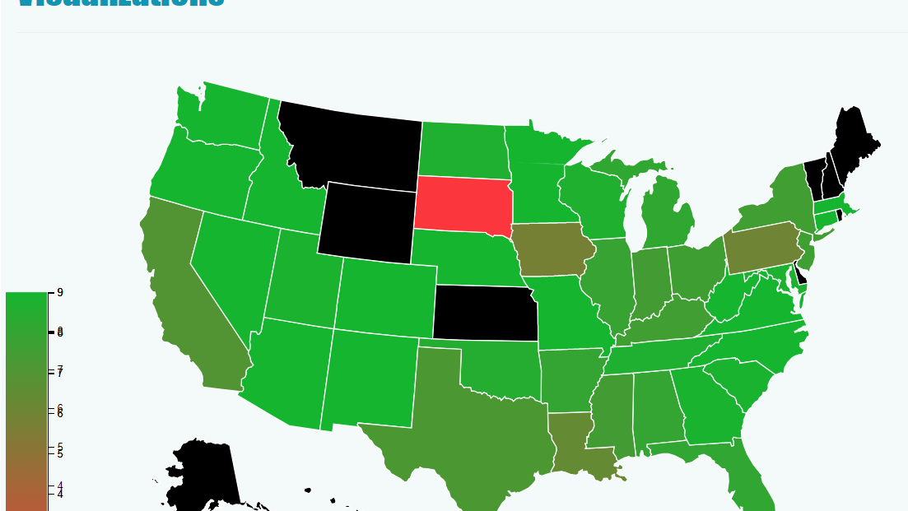
Chloropleth Map | State avgs

Slide 5
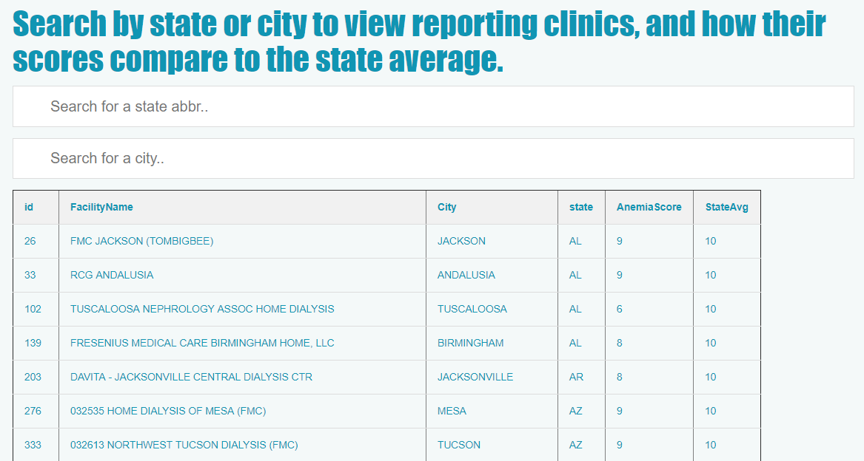
Filterable table| reporting clinics

Slide 6
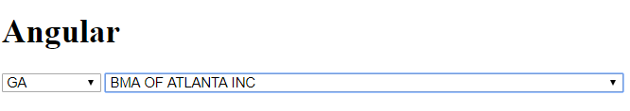
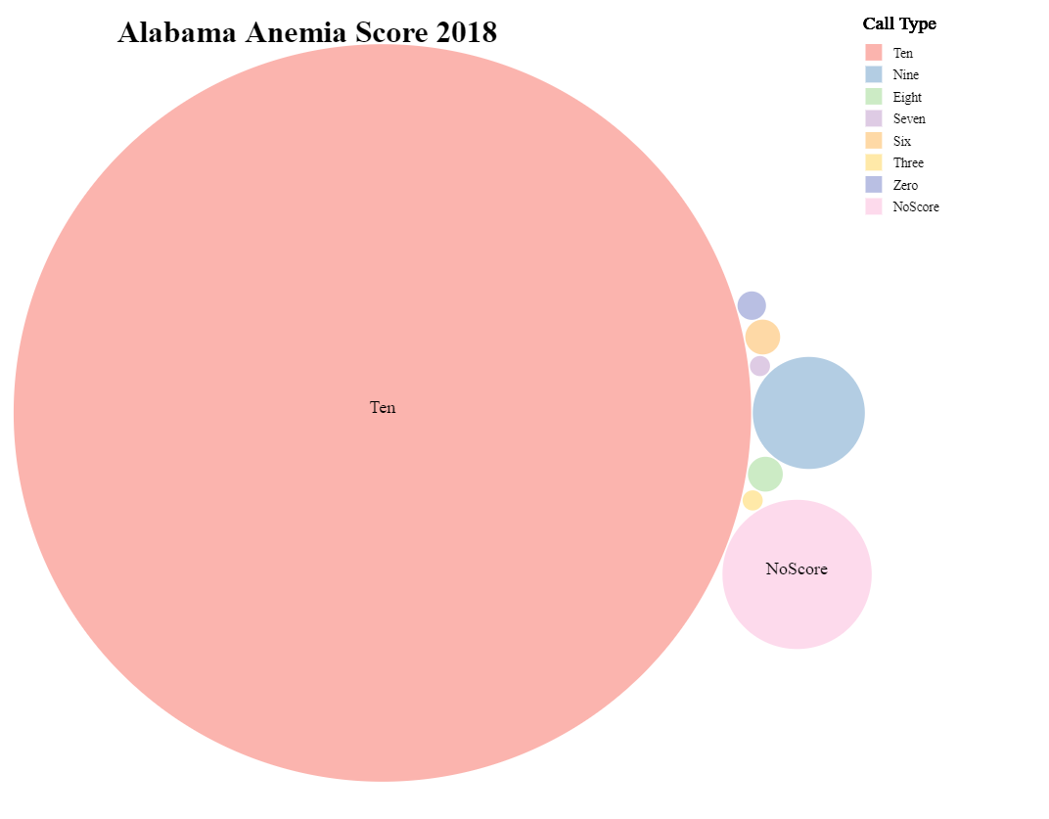
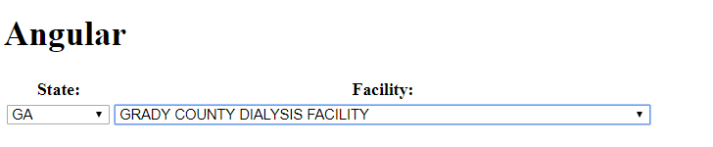
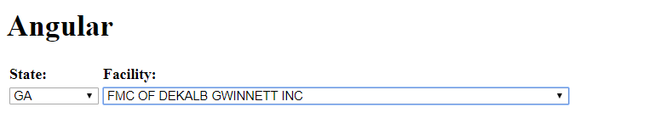
Other Attempts| Angular.JS, D3 Bubble Plot

Slide 7
Demo
Local:5000

Slide 8
Thank you
Questions?

